Slide 1
Weekend Congestion and Incident Analysis
Alex
Samarth
Raghu

Slide 2
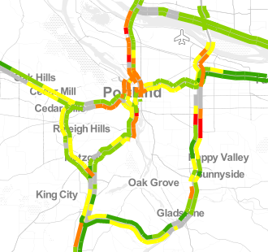
PORTAL data
Collected every 20 seconds: speed, Volume, etc. We care about speed
Data is automatically aggregated into five minute, 15 minute, daily, and monthly resolution. We used five minute resolution.
ODOT performance reports look at weekday traffic metrics, so our project looks at weekend congestion
End goal is a heatmap for a given highway, per day (Sat or Sun), per year

Slide 3
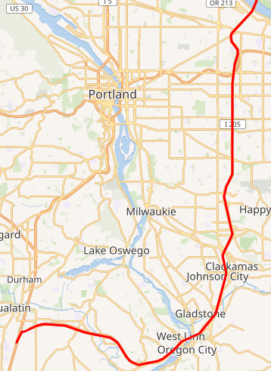
Project specifications (congestion)
We were asked to look at three highways: I-205 NB, I-84 WB, US26 EB
Seven years: 2012-2018
52 weeks * 2 (Sat, Sun) days per year
104 days * 7 years * 3 highways = 2,184 days worth of traffic data
Average day of traffic data is around 15,000 rows

Slide 4
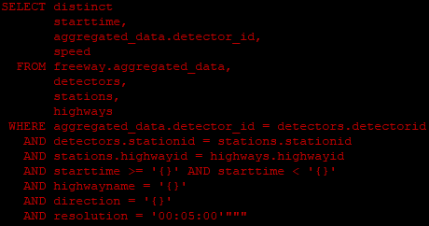
Congestion data challenges (retrieval of data)
One day of highway congestion data contains approximately 10-20k rows and takes 1-3 seconds to fetch from the database
This is a production database that I really don’t want to take down
Solution: create a script that queries the database for one day of data at a time

Slide 5
Congestion data analysis
We have the data, now what? (40,000,000 rows)
Data must be aggregated, or else it will take years to perform analysis
Average speeds, grouped by time of day and milepoint, per highway, year, and day of week
Original format: starttime, detector_id, speed, …
After aggregation:
time, milepost, speed

Slide 6
US-26 (Eastbound)

Slide 7
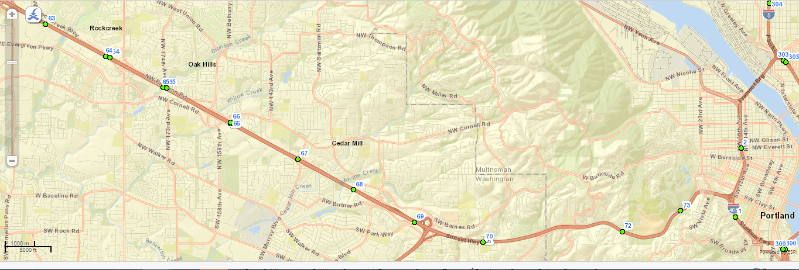
US-26 Milepost Map

Slide 8
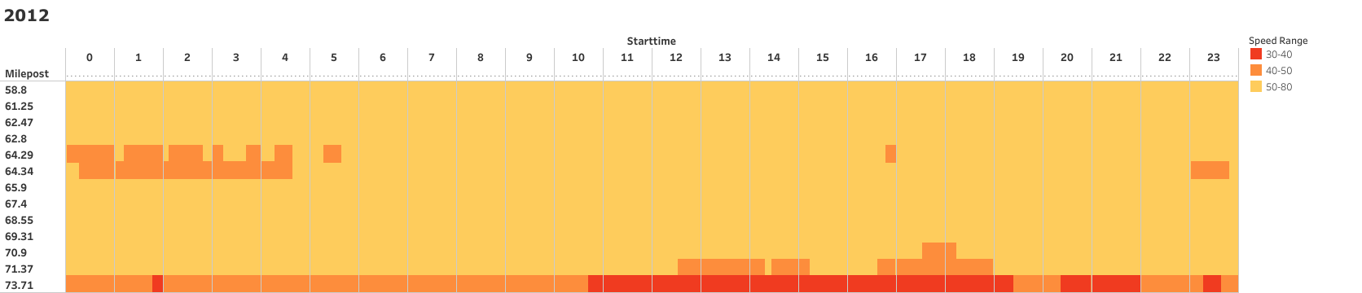
US-26 (EB) - Saturdays (2012)

Slide 9
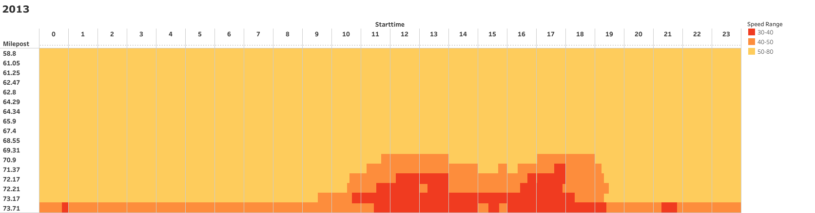
US-26 (EB) - Saturdays (2013)

Slide 10
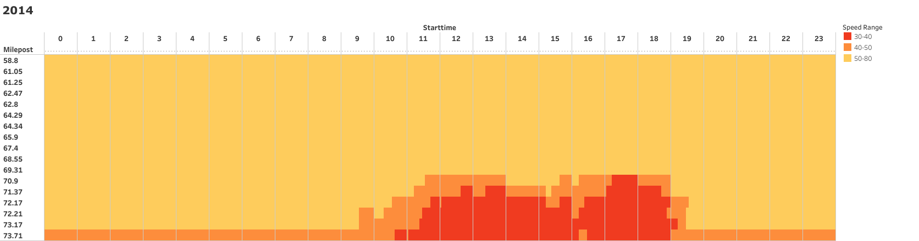
US-26 (EB) - Saturdays (2014)

Slide 11
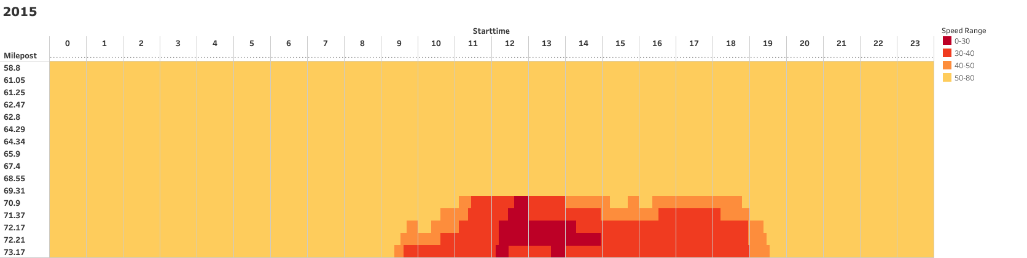
US-26 (EB) - Saturdays (2015)

Slide 12
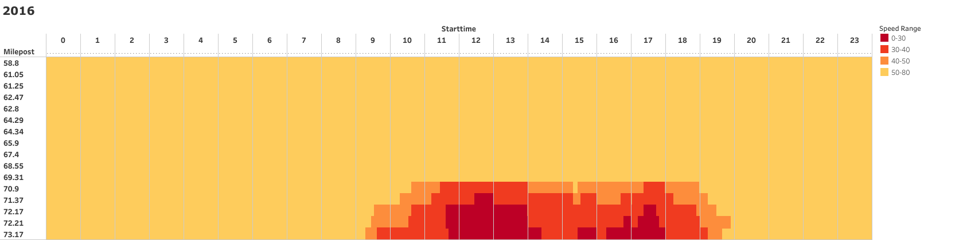
US-26 (EB) - Saturdays (2016)

Slide 13
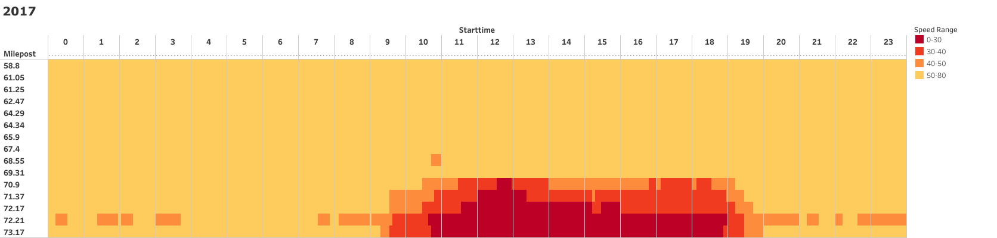
US-26 (EB) - Saturdays (2017)

Slide 14
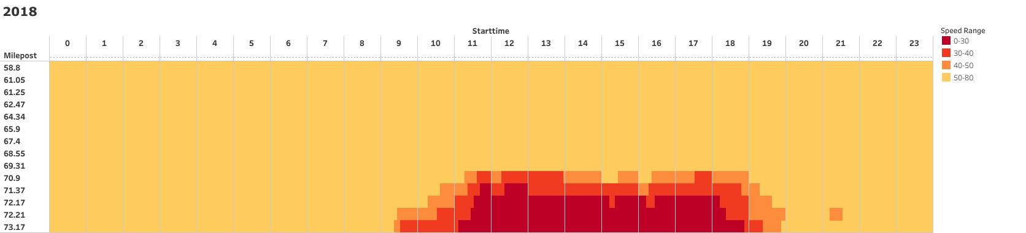
US-26 (EB) - Saturdays (2018)

Slide 15
US-26 (Eastbound) - Sundays

Slide 16
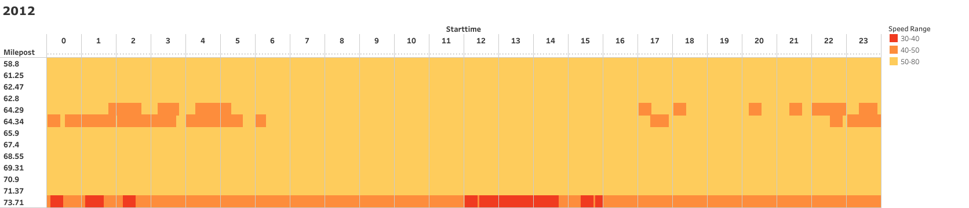
US-26 (EB) - Sundays (2012)

Slide 17
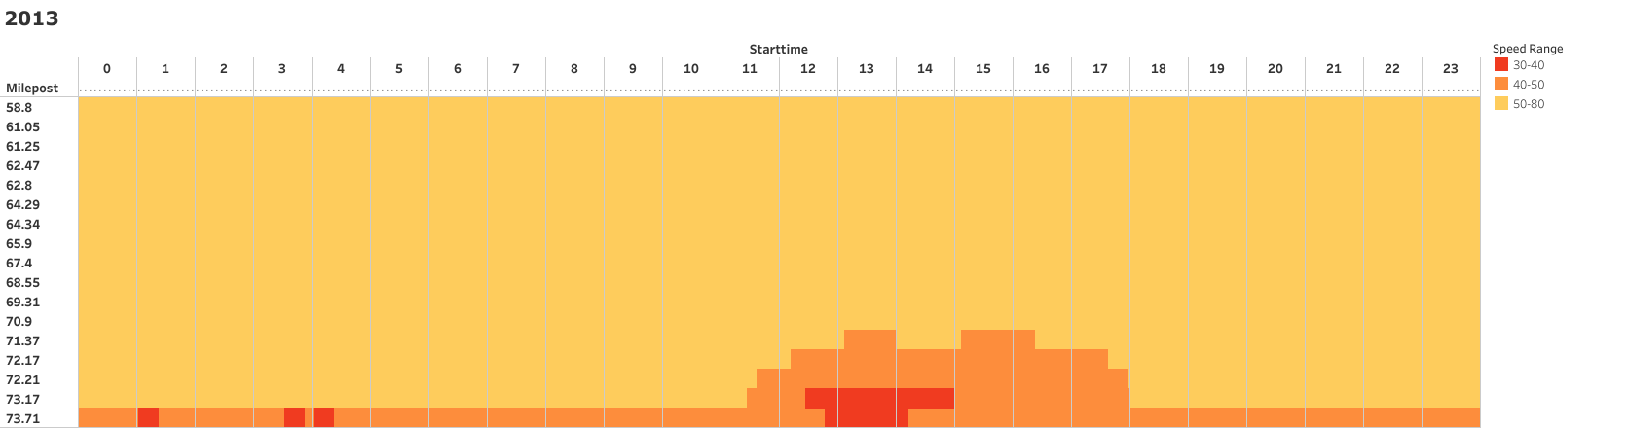
US-26 (EB) - Sundays (2013)

Slide 18
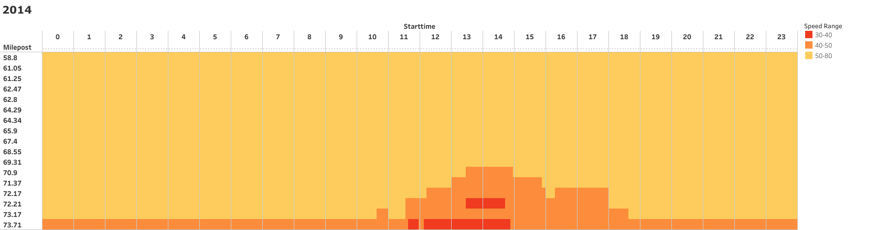
US-26 (EB) - Sundays (2014)

Slide 19
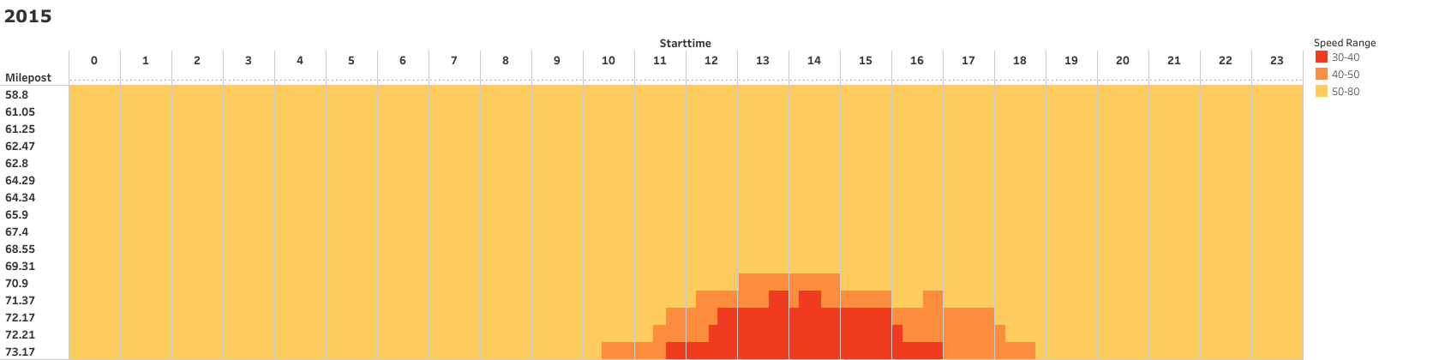
US-26 (EB) - Sundays (2015)

Slide 20
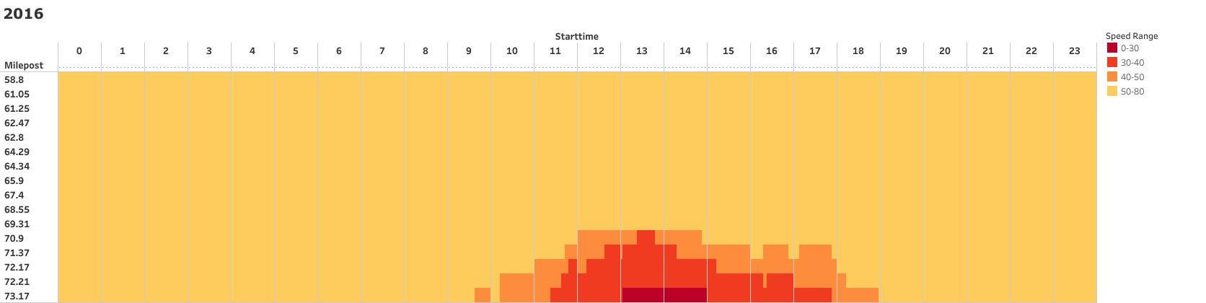
US-26 (EB) - Sundays (2016)

Slide 21
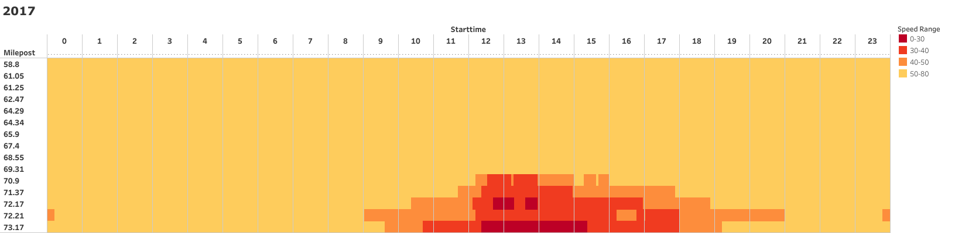
US-26 (EB) - Sundays (2017)

Slide 22
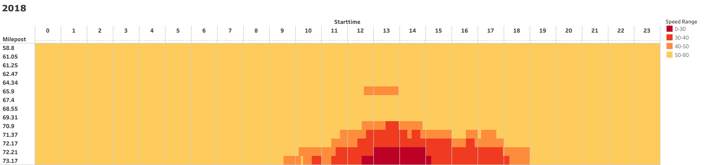
US-26 (EB) - Sundays (2018)

Slide 23
I-205 (Northbound)

Slide 24
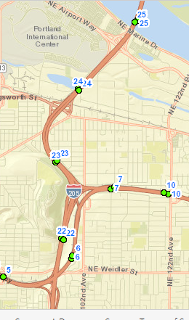
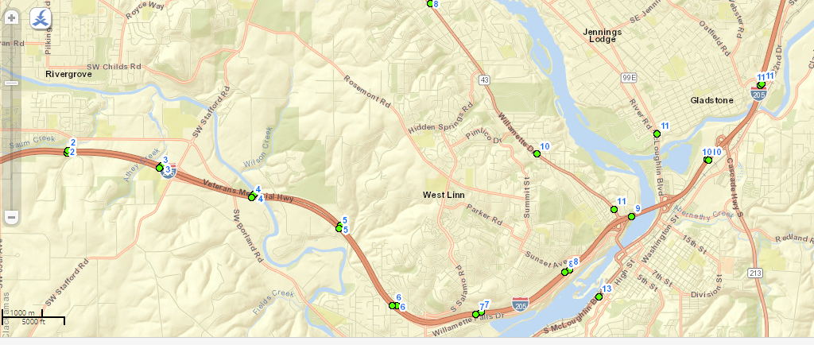
I-205 Milepost Map

Slide 25
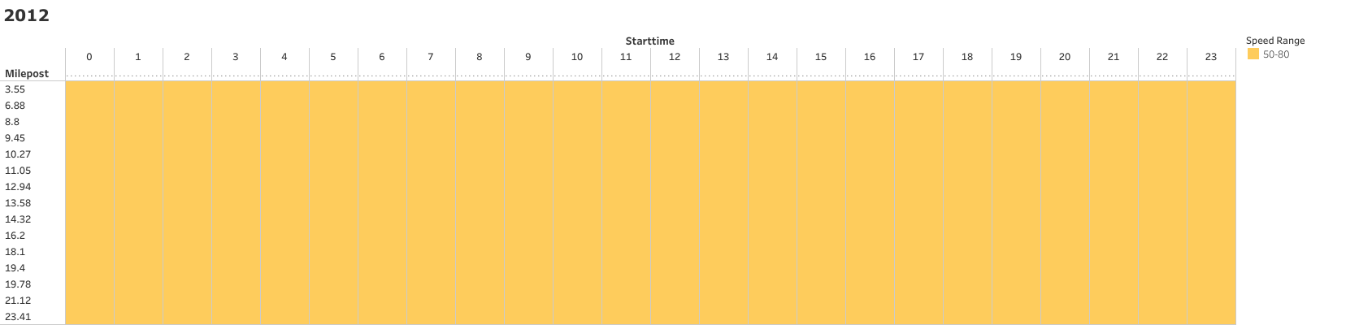
I-205 (NB) - Saturdays (2012)

Slide 26
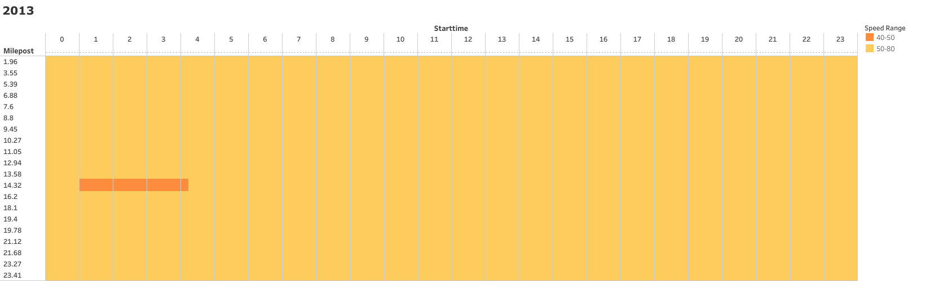
I-205 (NB) - Saturdays (2013)

Slide 27
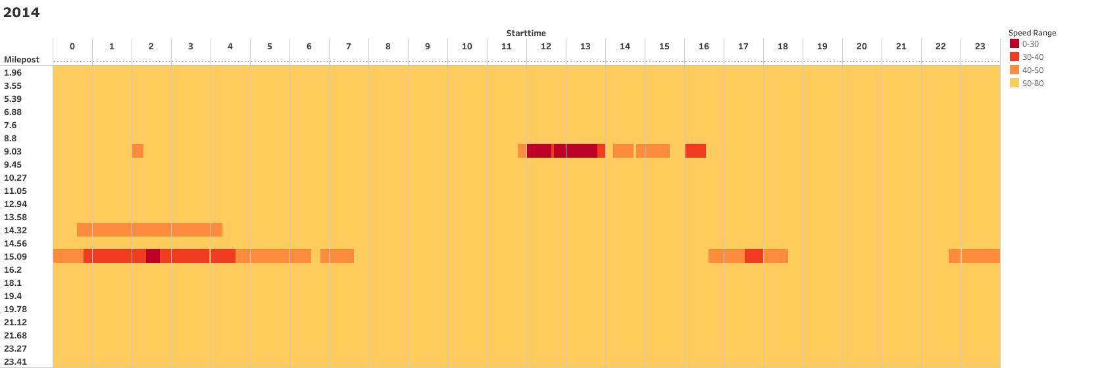
I-205 (NB) - Saturdays (2014)

Slide 28
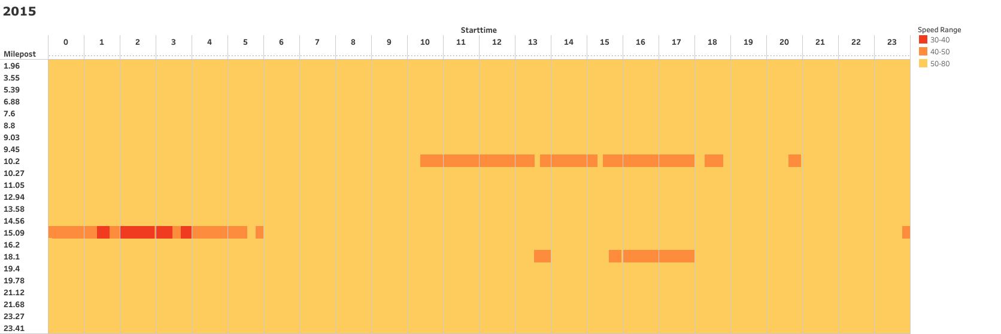
I-205 (NB) - Saturdays (2015)

Slide 29
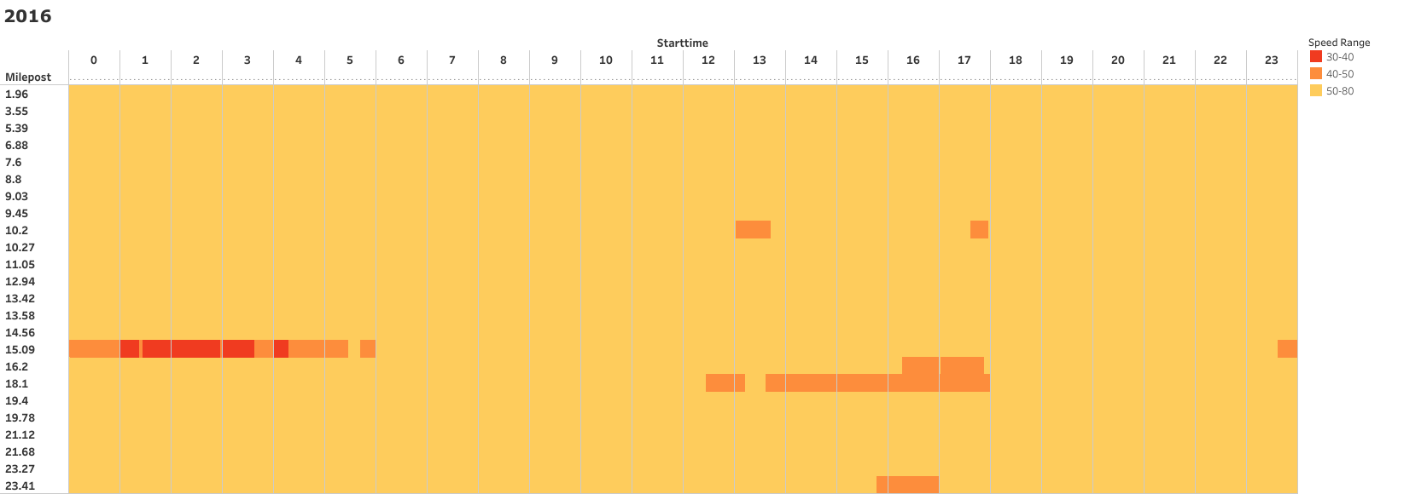
I-205 (NB) - Saturdays (2016)

Slide 30
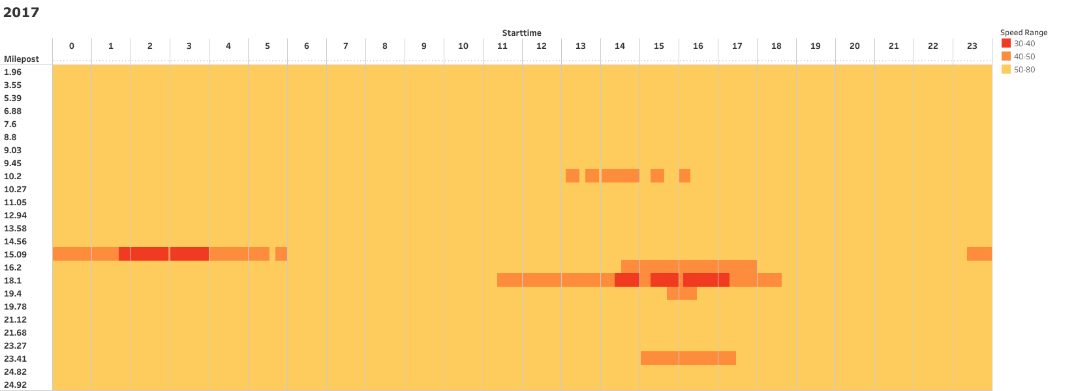
I-205 (NB) - Saturdays (2017)

Slide 31
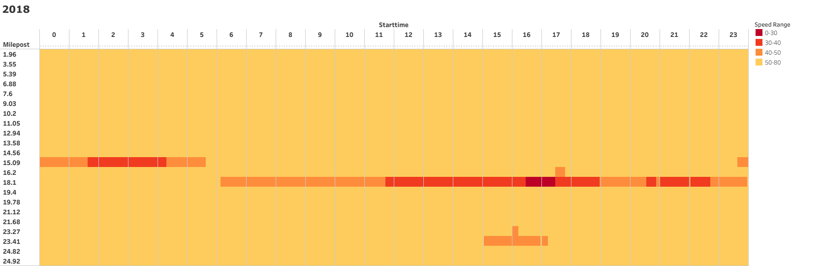
I-205 (NB) - Saturdays (2018)

Slide 32
I-205 (Northbound) - Sundays

Slide 33
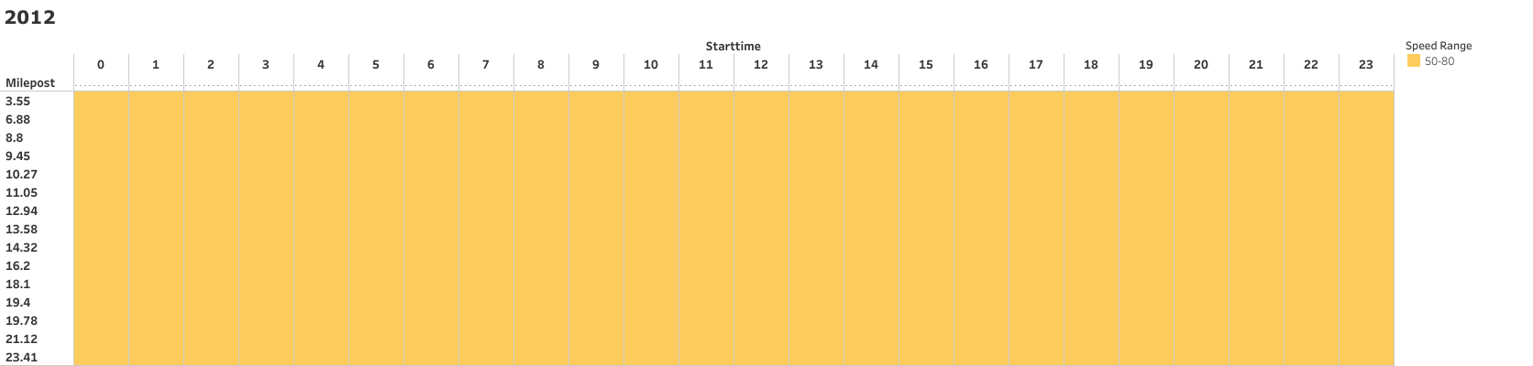
I-205 (NB) - Sundays (2012)

Slide 34

I-205 (NB) - Sundays (2013)

Slide 35
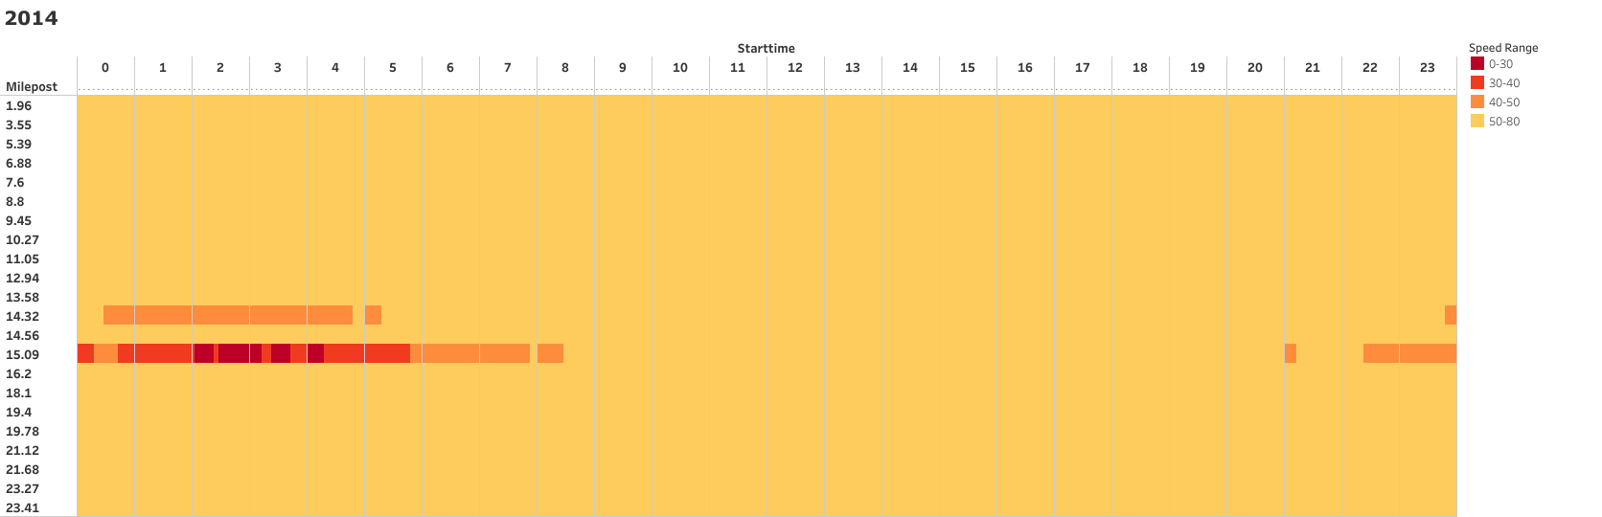
I-205 (NB) - Sundays (2014)

Slide 36
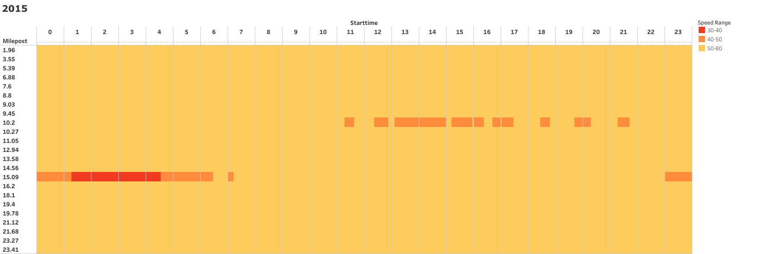
I-205 (NB) - Sundays (2015)

Slide 37
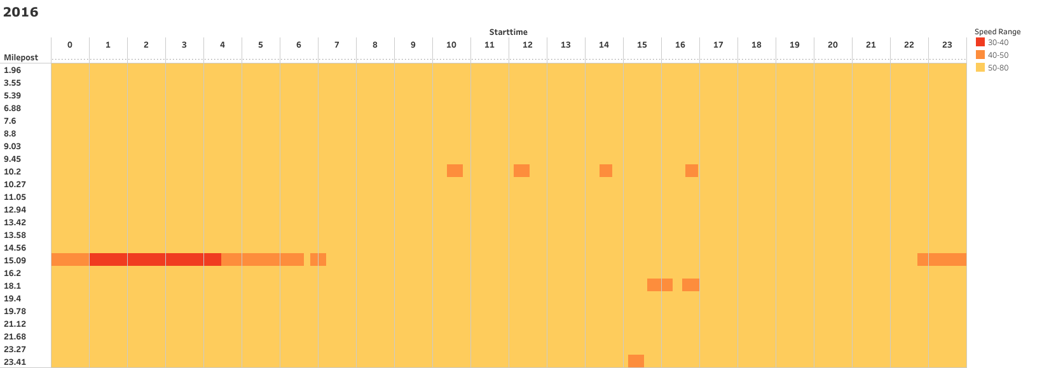
I-205 (NB) - Sundays (2016)

Slide 38
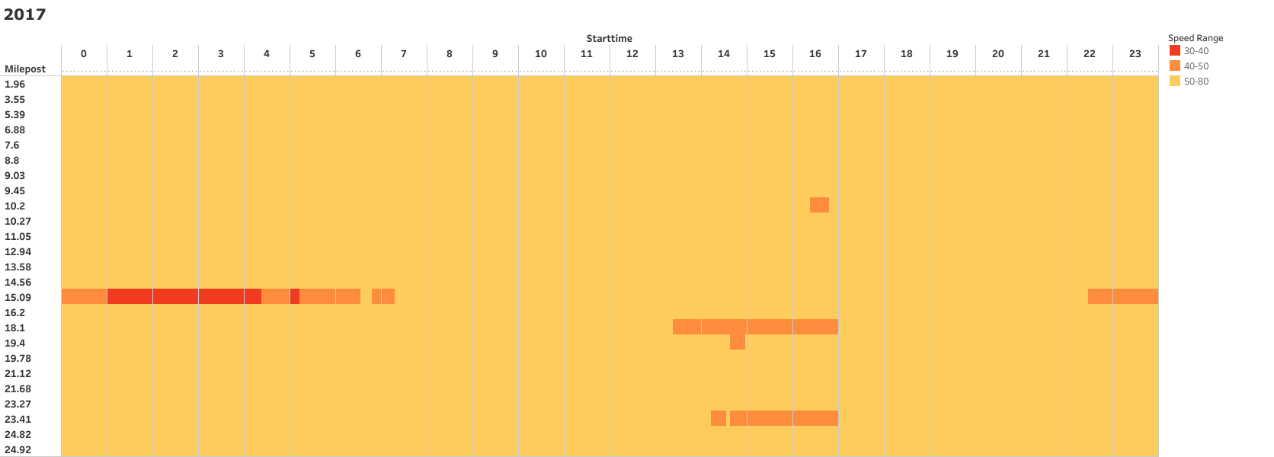
I-205 (NB) - Sundays (2017)

Slide 39
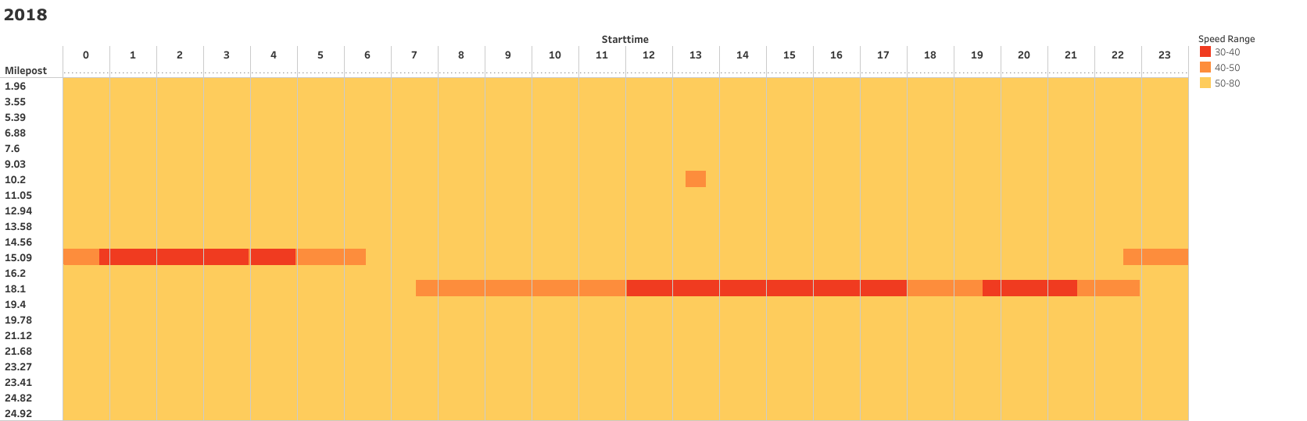
I-205 (NB) - Sundays (2018)

Slide 40
I-84 (Westbound)

Slide 41
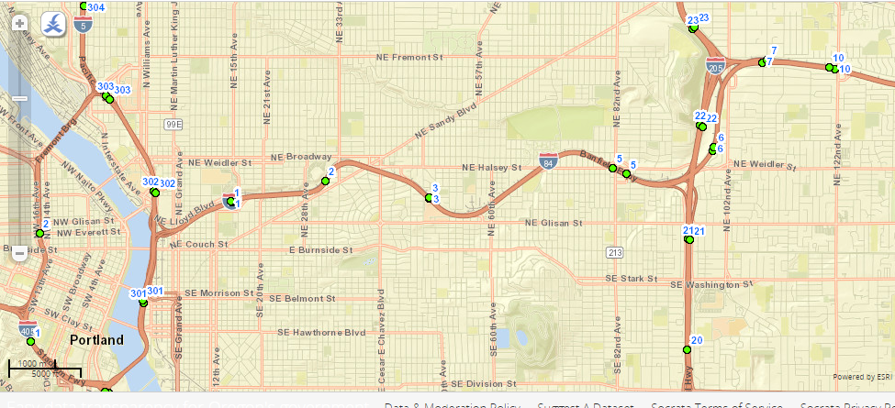
I-84 Milepost Map

Slide 42
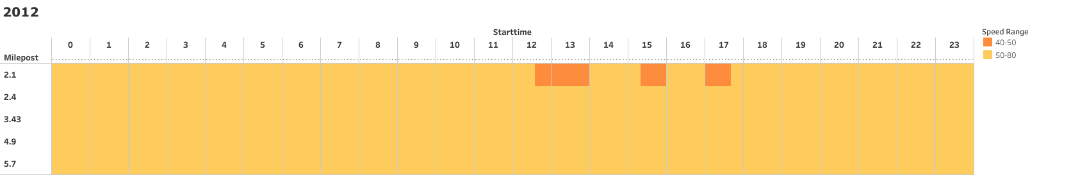
I-84 (WB) - Saturdays (2012)

Slide 43
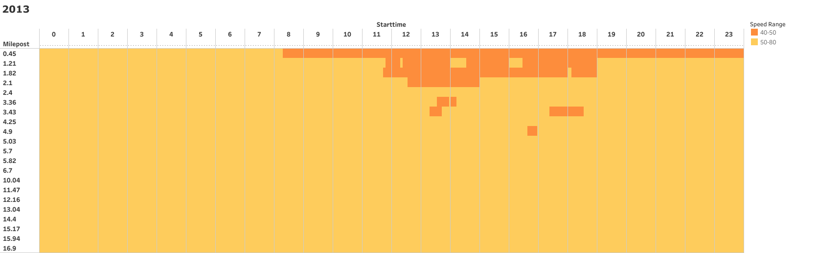
I-84 (WB) - Saturdays (2013)

Slide 44
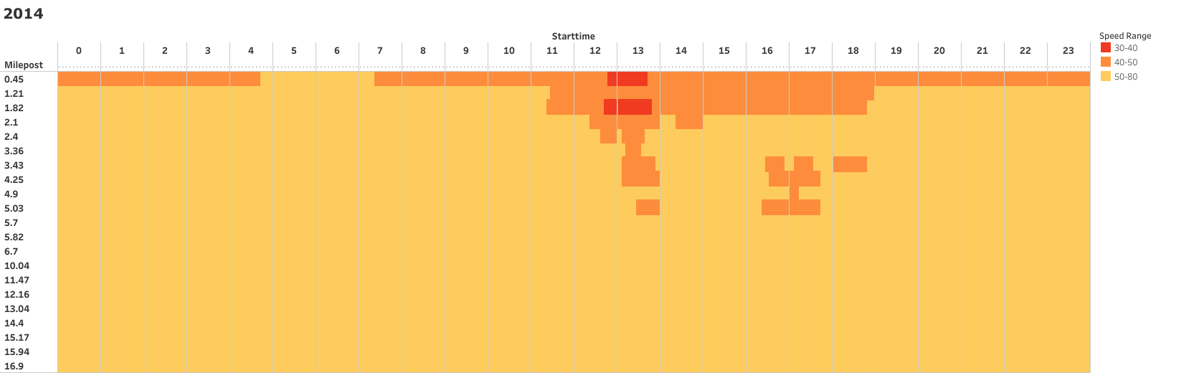
I-84 (WB) - Saturdays (2014)

Slide 45
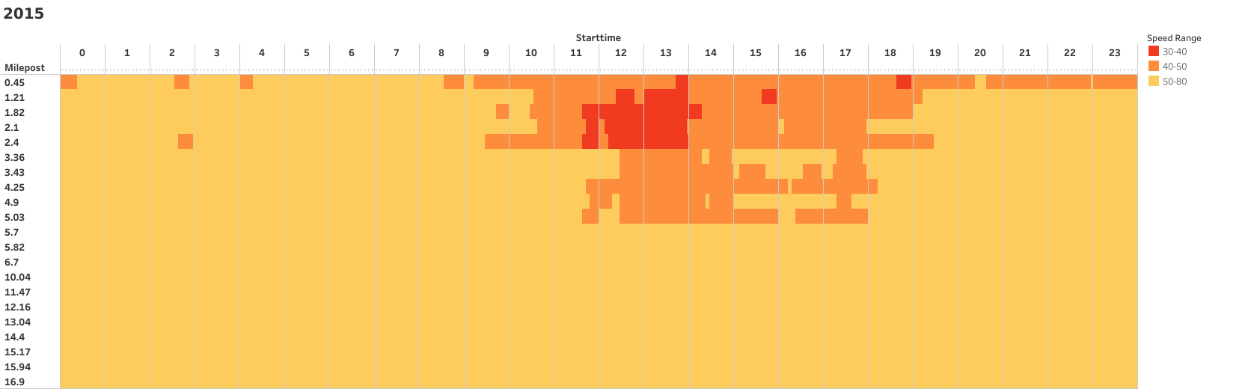
I-84 (WB) - Saturdays (2015)

Slide 46
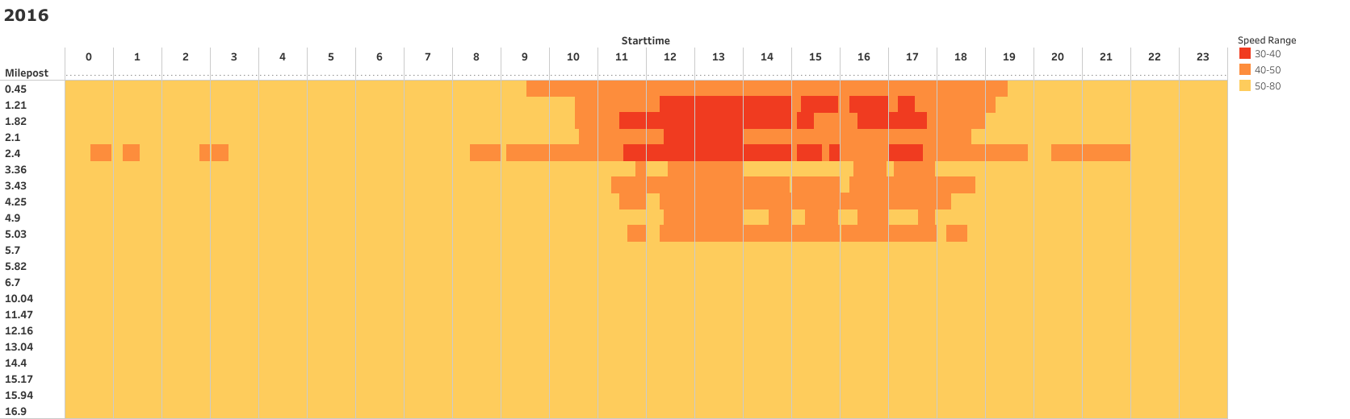
I-84 (WB) - Saturdays (2016)

Slide 47
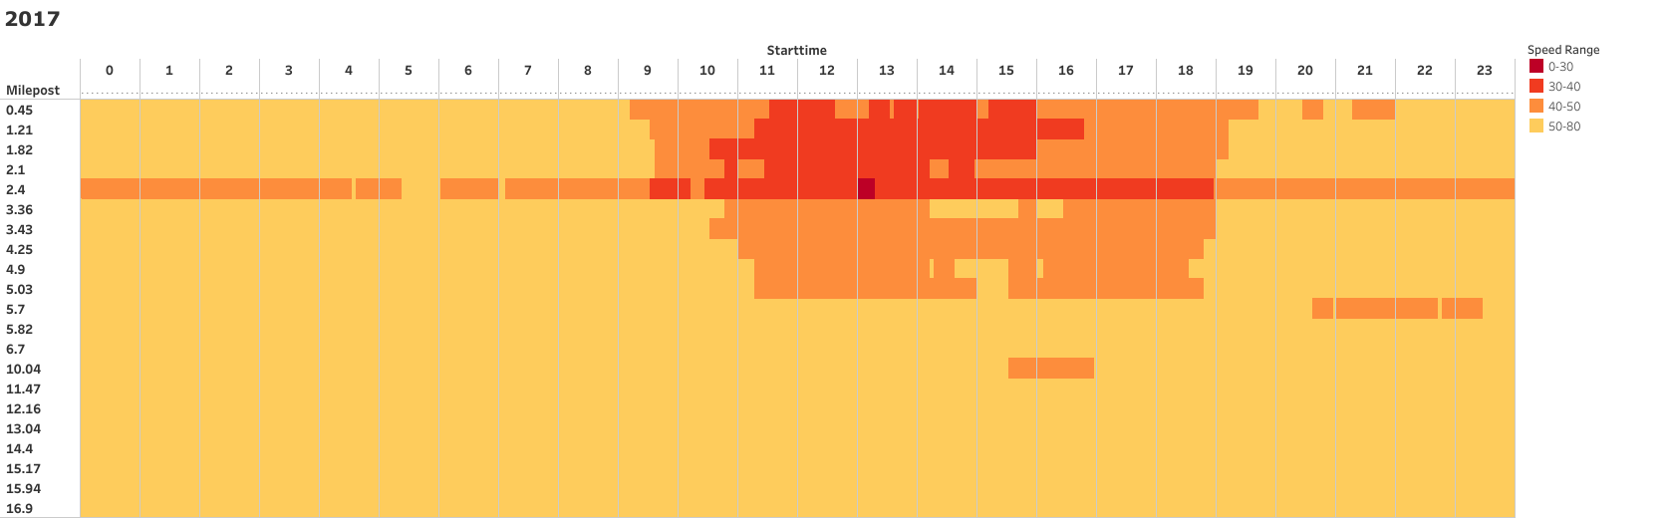
I-84 (WB) - Saturdays (2017)

Slide 48
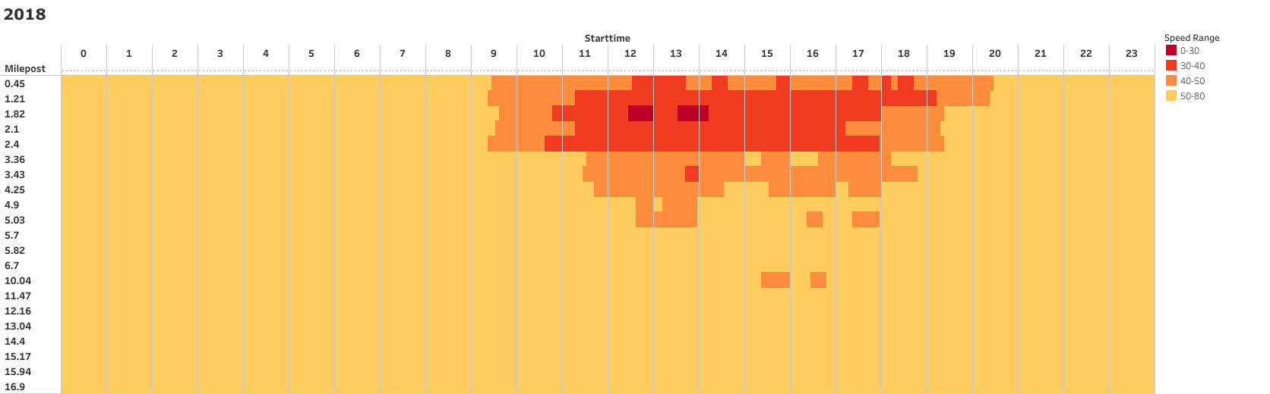
I-84 (WB) - Saturdays (2018)

Slide 49
I-84 (Westbound) - Sundays

Slide 50
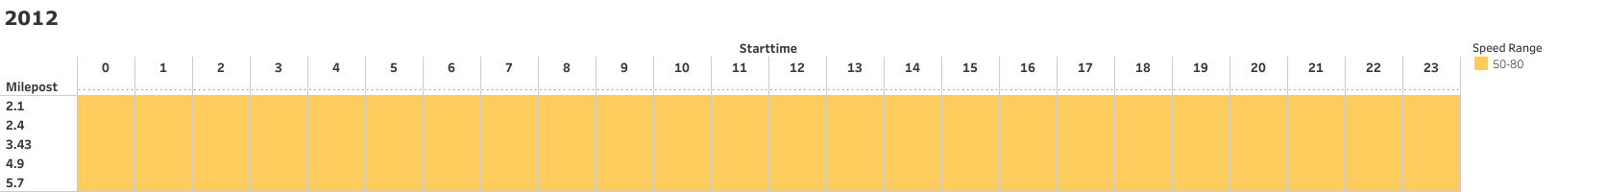
I-84 (WB) - Sundays (2012)

Slide 51
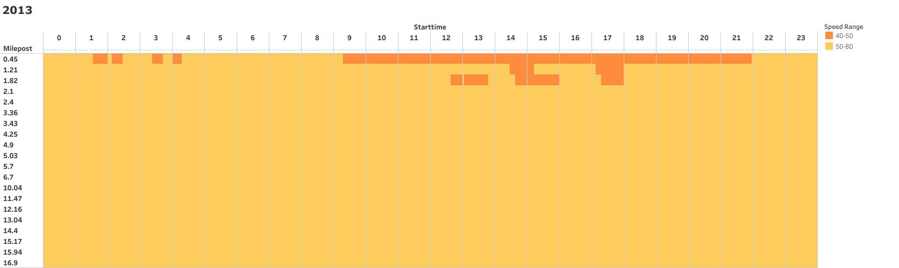
I-84 (WB) - Sundays (2013)

Slide 52
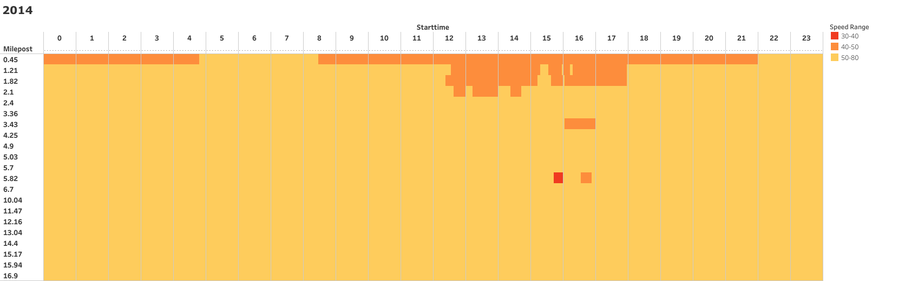
I-84 (WB) - Sundays (2014)

Slide 53
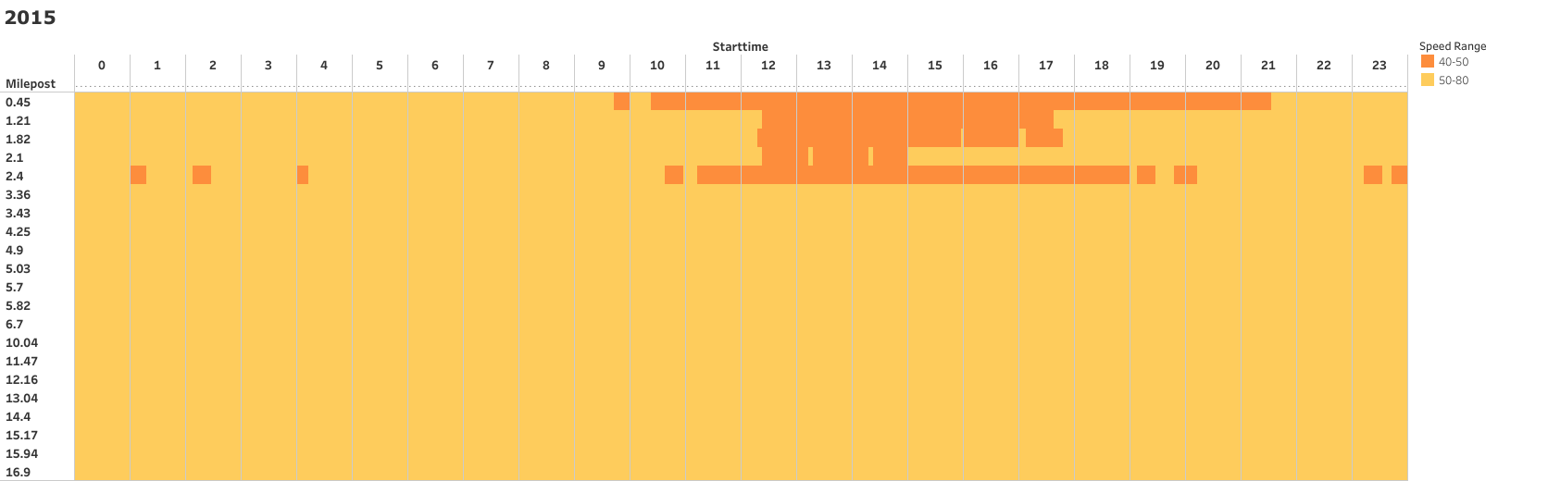
I-84 (WB) - Sundays (2015)

Slide 54
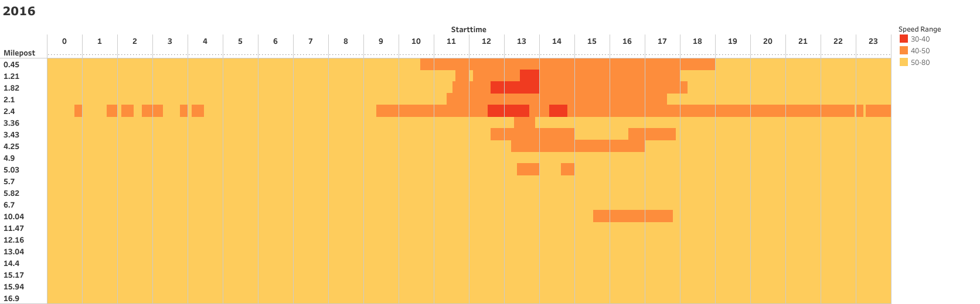
I-84 (WB) - Sundays (2016)

Slide 55
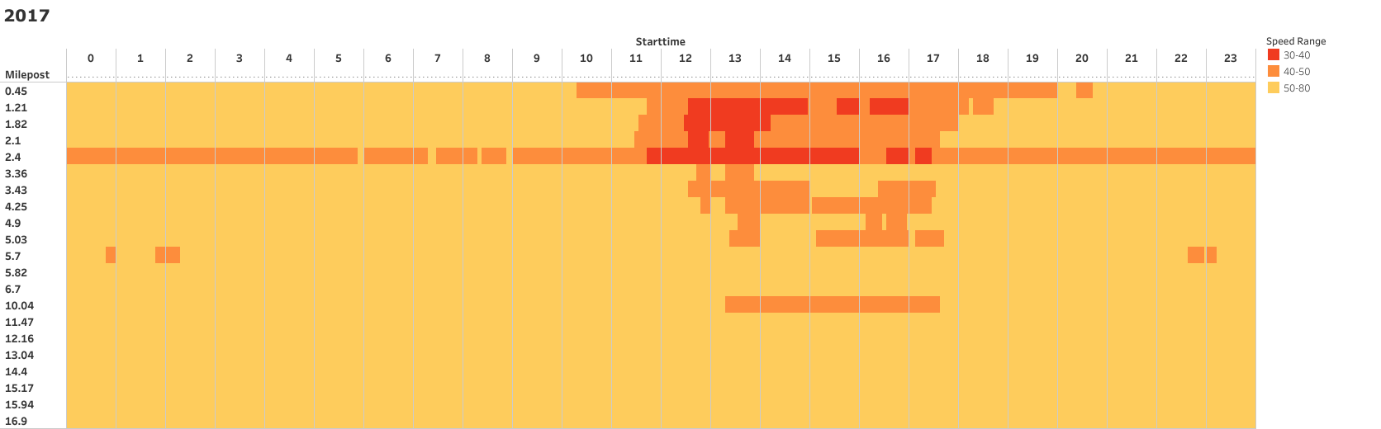
I-84 (WB) - Sundays (2017)

Slide 56
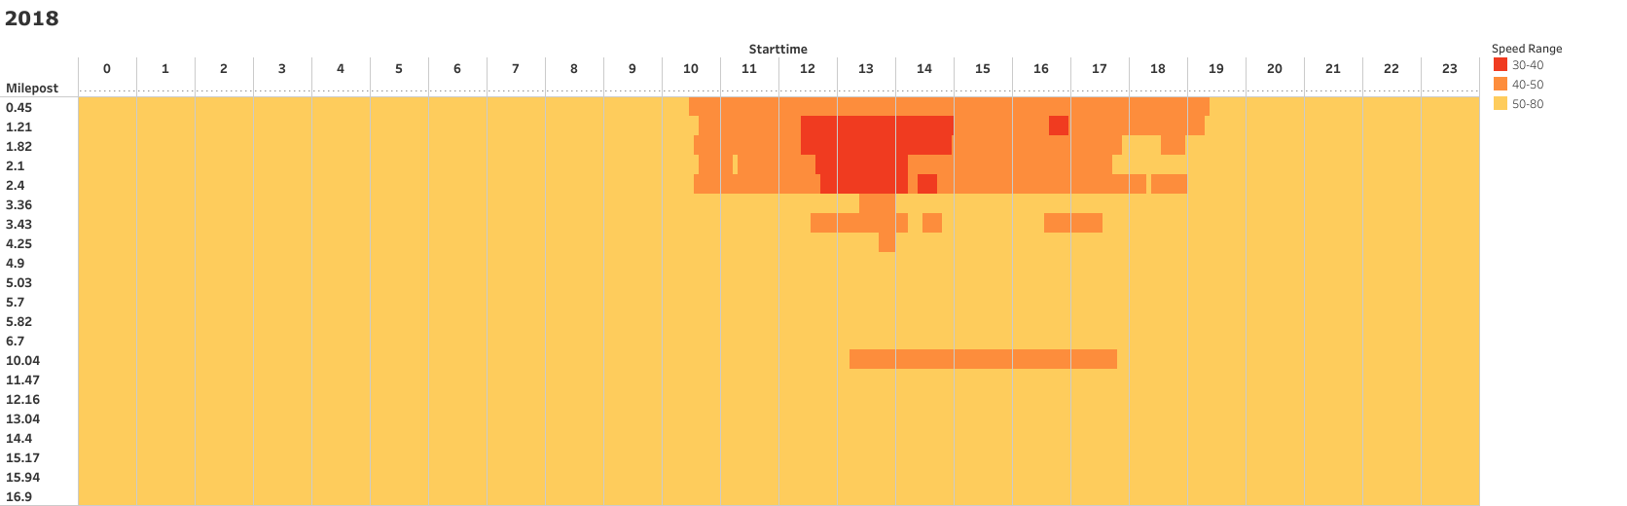
I-84 (WB) - Sundays (2018)

Slide 57
Reasons for congestion:
Too many cars for the roadway due to inadequate mass transit options or other reasons.
Obstacles in the road causing a blockage and merger. These can be any of the following:
Double parking
Road work
Lane closure due to utility work
Road narrowing down
An accident

Slide 58
Reasons for congestion: (contd.)
Traffic signals out of sync many times on purpose or occasionally when the computers are malfunctioning.
Inadequate green time
Too many pedestrians crossing not permitting cars to turn
Too many trucks on the road due to inadequate rail freight opportunities
Overdevelopment in areas where the mass transit system is already overcrowded and the road system is inadequate.

Slide 59


Incident Analysis

Slide 60
Incident Data
ODOT maintains a data of all the incidents and crashes.
Not all incidents are crashes
Our project aims analyse incidents during weekends
We have also looked at crash analysis

Slide 61
Project specifications (congestion)
We were asked to look at three highways: I-205 NB, I-84 WB, US26 EB
Seven years: 2012-2018
52 weeks * 2 (Sat, Sun) days per year
104 days * 7 years * 3 highways = 2,184 days worth of traffic data

Slide 62

Notes:
Biggest learning -
Need for interactive visualizations

Slide 63
Learnings
Set small goals - Sanity checks
Exposure to different stages of data science
Use of a visualization tool - Tableau
And a lot about transportation and roadways

Slide 64

Future scope
Further analysis - Why the way it is
Congestion - Incident/Crash relations
Weekend vs Weekday Traffic Analysis

Slide 65


